Slide 1

V
DOCTOR APPOINTMENT
Project Guide: Presented by:
Mr.P.Muthyalu, K.Anusha 152H1A0549
ASSISTANT PROFESSOR, B.Triveni 152H1A0508
DEPT of CSE, M.Jahnavi 152H1A0558
ASIT. K.Suvarna 152H1A0551
P.Madan Kumar 152H1A0576

Slide 2
CONTENTS:
Abstract
Existing System
Disadvantages
Proposed System
Advantages
Modules
System Requirements
Roles And Services
UML Diagrams
Execution Procedure
Conclusion

Slide 3
ABSTRACT:
Doctors Appointment app is useful for booking appointments to consult a doctor without going to hospital.
This app will handles the information about Doctor Consultation and Scheduling, Doctor Consultancy Fees and Time Allocation.
User can search for the doctors based on their Specialty, Time and Consultancy Fees and can book the appointment.
Once the booking is confirmed, then user will get an SMS regarding the confirmation of booking.

Slide 4
EXISTING SYSTEM:
Now a days people are getting ill frequently because of current environment. Some of may don’t know which doctor to consult. For that they need to go to hospital and stand in a queue for taking a new OP and wait for their turn in order to consult the doctor.
It is a waste of time and Energy. If a person who is in out of city wants to book an appointment then it is a difficult task for him to go to hospital.

Slide 5
DISADVANTAGES:
Standing in a queue for taking new OP.
Waiting for your turn to consult a doctor is a waste of time.
If we lost the OP then we need to take the new one.

Slide 6
PROPOSED SYSTEM:
The proposed app is useful for booking appointments to consult a doctor without going to hospital.
This app will handles the information about Doctor Consultation and Scheduling, Doctor Consultancy Fees and Time Allocation.
User can search for doctor based on their Specialty, Time and Consultancy Fee and can book the appointment. Once the booking is confirmed, then the user will get an SMS regarding the confirmation of booking.

Slide 7
ADVANTAGES:
No need of Waiting in a queue for taking new OP.
If a person is in out of city, he/she can book the appointment easily without going to hospital.
Can save Time.
Anyone can book the appointment.
More flexible and can be accessed if the mobile has internet.
Can take the Snapshot of OP.

Slide 8
MODULES:
Register
Login
Database
Register:
Every Doctor must get registered in the registration form to move next login page. After login he will get the information list and information about the people who booked appointment at particular time and date.

Slide 9
Login:
After completing the registration page only the user can login. User must enter the login correct details as entered in the registration form.
Database:
The database used in our application is for storing the data of the registered doctors, for login credentials and patients who are booking appointments. The details can be stored in the form of tables.

Slide 10
SYSTEM REQUIREMENTS:
Hardware Requirements:
Operating System: Windows 7/8/10
Processor: Pentium IV or higher.
RAM: 4GB
Space on Hard Disk: Minimum 4GB
Android studio.
For running the application:
Android device: Android version 4.0 and higher.

Slide 11
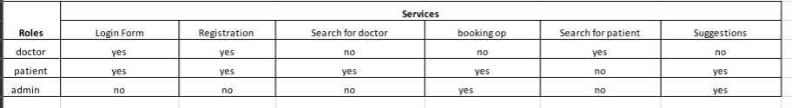
ROLES AND SERVICES:

Slide 12
CLASS DIAGRAM:
A Class is a collection of objects with attributes and operations or methods.
An attribute is a property/characteristic of an entity.
Operation is a type of method.
Class diagram is a static diagram defines static architecture of a model.
Class diagram is a structural diagram defines the basic architecture of a model.

Slide 13
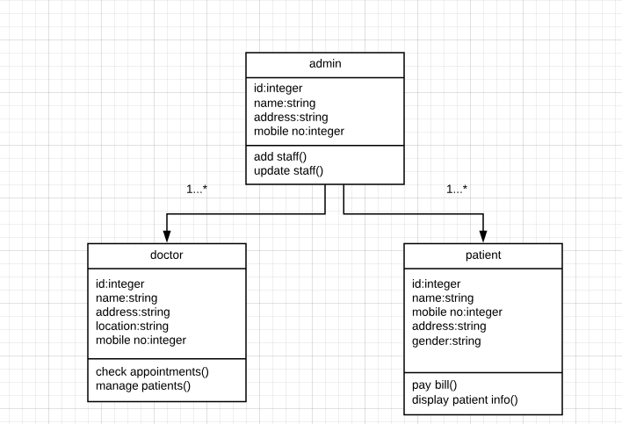
Fig Class Diagram

Slide 14
USE CASE DIAGRAM:
It is a requirement of unified modeling language. It behaves functionality of the unified modelling language.
It simply understandable diagram of UML.
Actor is the major part in use case diagram, communicates with the system.
Use case is also part in use case diagram, gives us utilization of task or action.
Associates plays major role between actor& use cases.

Slide 15
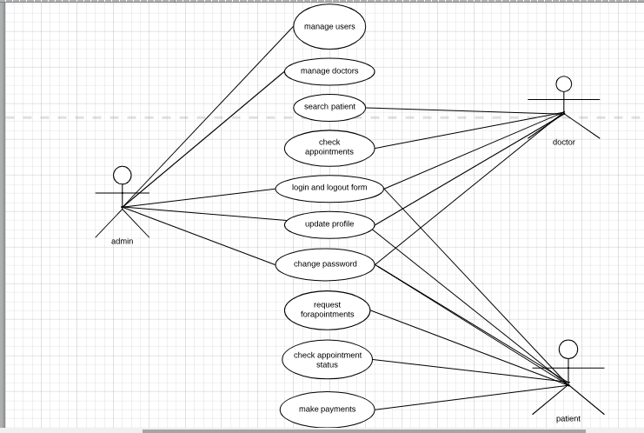
Fig Use case Diagram

Slide 16
SEQUENCE DIAGRAM:
Sequence diagram is a interaction diagram i.e. interaction between steps or action. Sequence diagram is a dynamic behavior diagram i.e. including actors, objects and messages.
Sequence diagram focus on time ordering of the objects.
Identify actors, objects and system within system overtime.
Interaction diagram are at their best when the behaviour is simple.
It shows potential interaction between objects in system, in the order in which they normally occur.
A sequence diagram shows as parallel vertical lines, different processes or objects that live simultaneously.

Slide 17
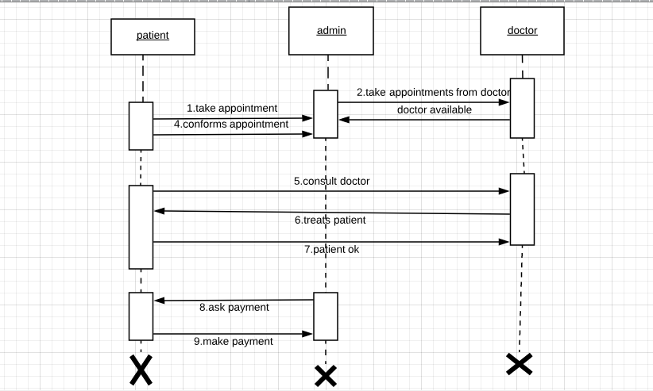
Fig Sequence diagram

Slide 18
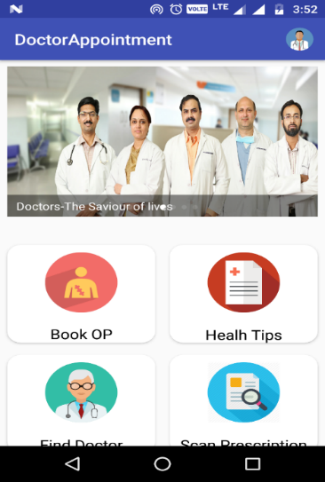
Execution Procedure:
User Open the app.
User can book an OP at particular Hospital
User can look into health tips.
User can find the doctor base on OP fee.
User can scan the prescription which was given to him by the doctor.
If the user is a doctor, he can login into the app and can find the patients who booked an OP at particular date and time.

Slide 19
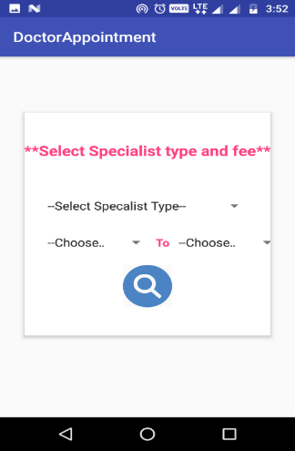
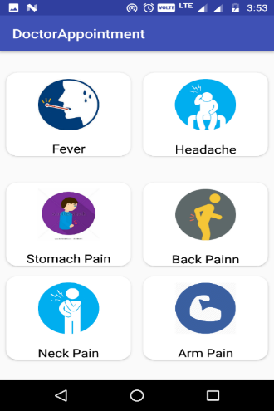
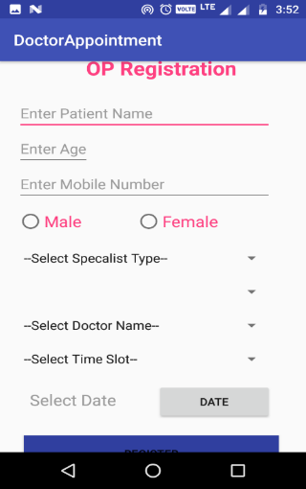
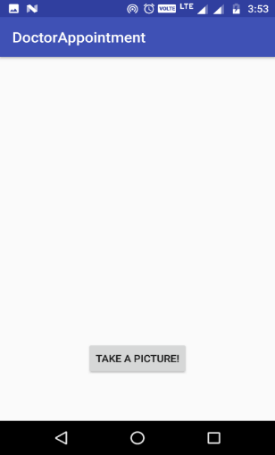
DESCRIPTION
The USER can open the app and can choose the modules he want either it may be booking an OP or finding the doctor base on fee or can look for health tips or for scanning the prescription.
Figure: Find doctor and Health Tips
Figure: OP Registration and Scan prescription

Slide 20
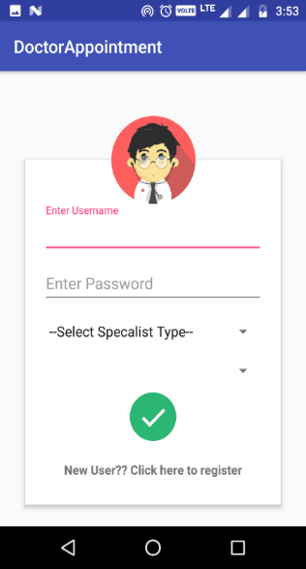
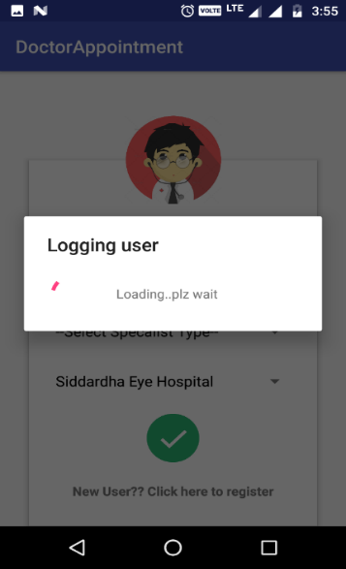
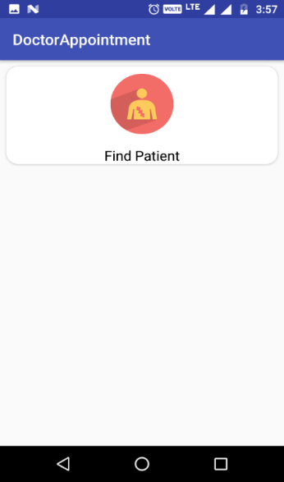
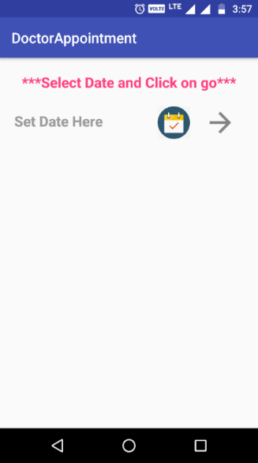
DESCRIPTION
This page will takes the doctor to his home screen where he can find the patients who booked OP in his hospital.
Figure: Doctor Home

Slide 21
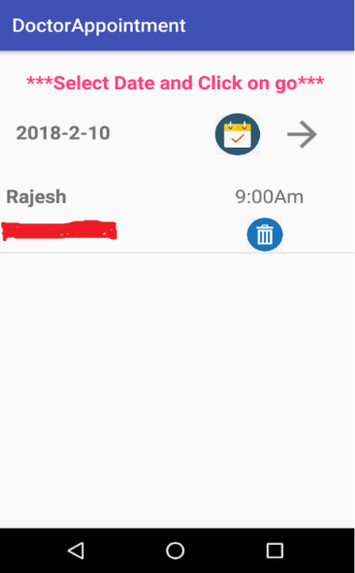
DESCRIPTION
This page will helps the doctor to load the patients data based on their OP booking date.
Figure.7.7: Displaying patients

Slide 22
CONCLUSION:
The completion of this project is providing the entire hospital information using android application.
The online doctor appointment android project aims for the user satisfaction for booking the appointment and providing more flexibility to the user.

Slide 23


